Slide 1

Team 3 - Food and drug administration (FDA) Recalls
Lynn Foster Jr.
Natalia galvan
Manuel Galvan
JOE ALMENDAREZ
Teddy Ziheng Song

Slide 2
Background FDA
The FDA is a US government agency which is part of the Department of Health and Human Services. The FDA's mission is to protect public health by regulating and ensuring the safety, efficacy, and security of many products. One of these products include food items.
Food items in violation of the US FDA regulations are recalled, which removes the recalled food item from the market
We analyzed 1000 recalled foods from the FDA for the time period of Jan 2020 – Dec 2024

Slide 3


Goal: Based on the Process for classification of Recalls, the selected model should predict the duration between the Center Classification Date vs Recall Initiation Date; basically predicting how long a recall is outstanding
Center Classification Date: The date that FDA classified the recalled products as Class I, II, or III
Recall Initiation Date: The date that the firm first began notifying the public or their consignees of the recall

Slide 4
Summary of ETL Process for FDA Recall Data
Extraction
API Integration:
Data was extracted from the FDA's public API endpoint https://api.fda.gov/food/enforcement.json.
Query parameters were used to filter data by report_date between 20200101 and 20241201.
The API response was processed as JSON, and relevant records were extracted into a Pandas Data Frame.
Transformation
Data Cleaning:
Removed records where the termination_date was missing or invalid.
Filtered data to retain only records with Country set to "United States.“
Unnecessary columns were removed from the dataset, such as openfda, product_description, and reason_for_recall, to streamline the data for analysis.
Renamed columns for consistency and readability (e.g., recall_initiation_date → Recall Initiation Date).
Date Formatting:
Reformatted date fields (Recall Initiation Date, Center Classification Date, Termination Date) from YYYYMMDD to proper Python datetime objects for easier manipulation and calculations.
Derived Metrics:
A new column, Days To Classify, was calculated as the difference in days between Recall Initiation Date and Center Classification Date.
Load
Database Integration:
Transformed data was loaded into a MongoDB database (fda_data) and stored in a collection named food_recalls.
Post-Processing:
Data was queried back from MongoDB into a Pandas Data Frame for further analysis and visualization.

Slide 5
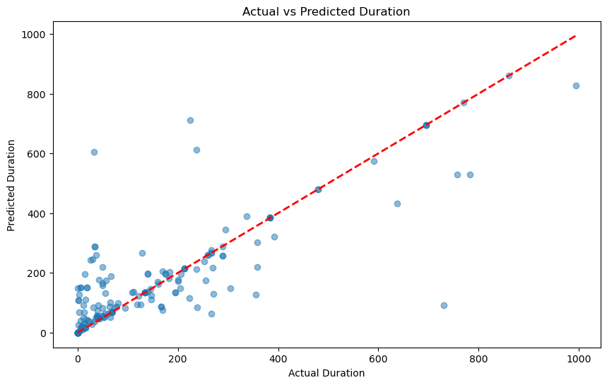
Actual vs Predicted Duration time for classification
The dataset was split into training and testing subsets, and the model was trained on the training data.
Performance metrics such as Mean Absolute Error (MAE), Root Mean Squared Error (RMSE), and R² Score were calculated to evaluate the model's accuracy.
A visualization comparing actual vs. predicted values highlighted the model's performance and reliability.

